Slide 1
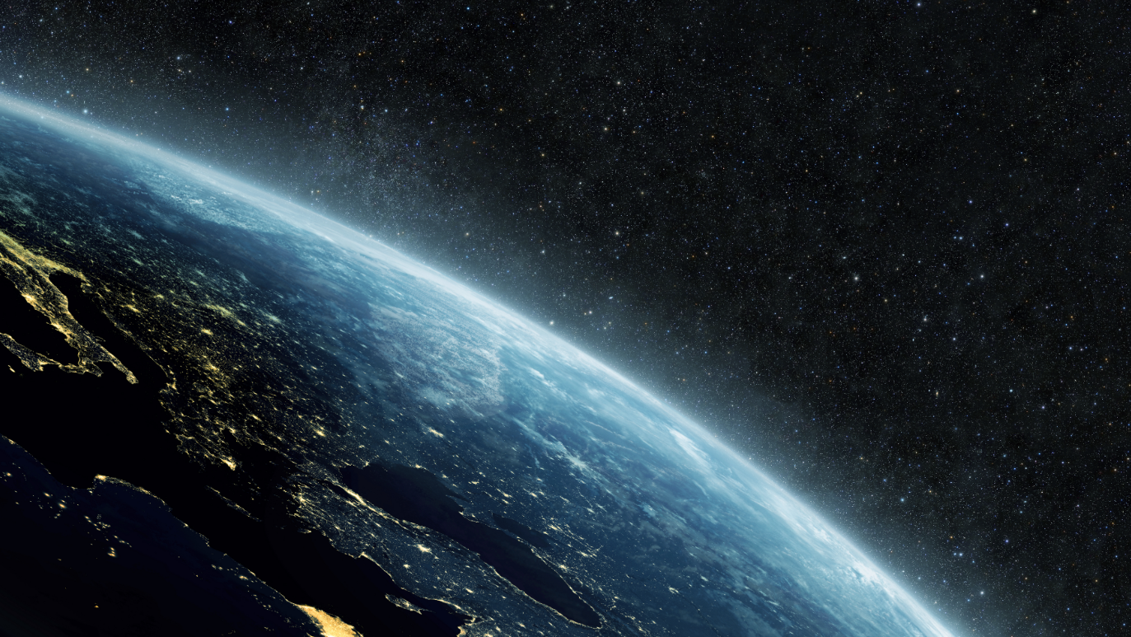
Stable Diffusion
Доклад подготовил
Марчук Иван
ИУ6-31М

Slide 2
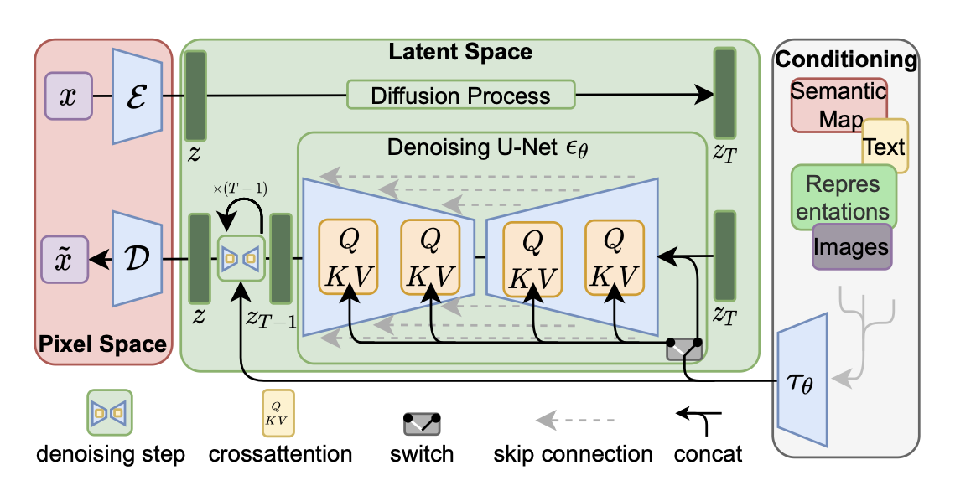
[2]
https://habr.com/ru/articles/693298/

Slide 3
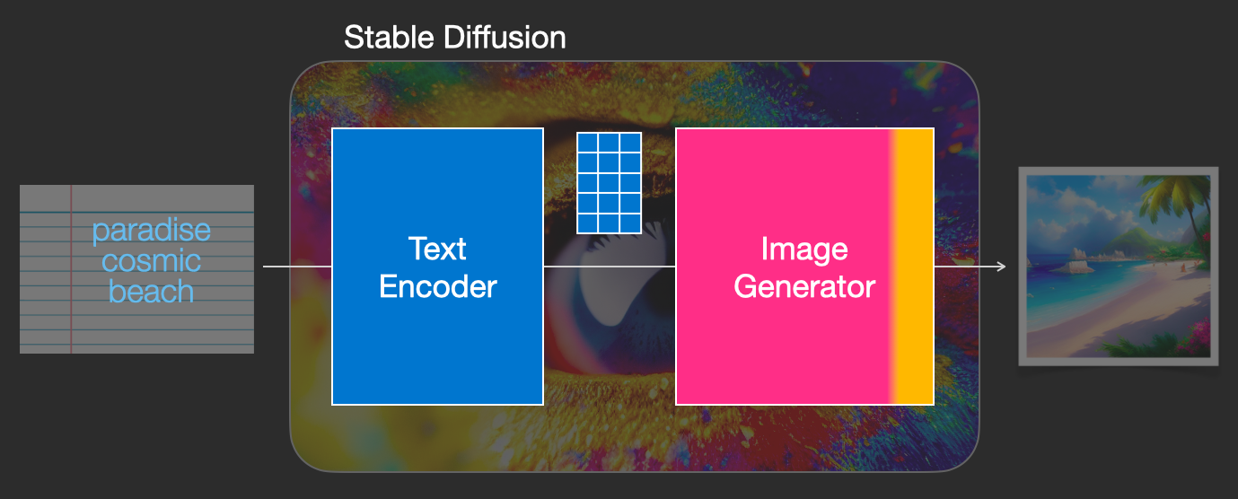
[3]

Slide 4
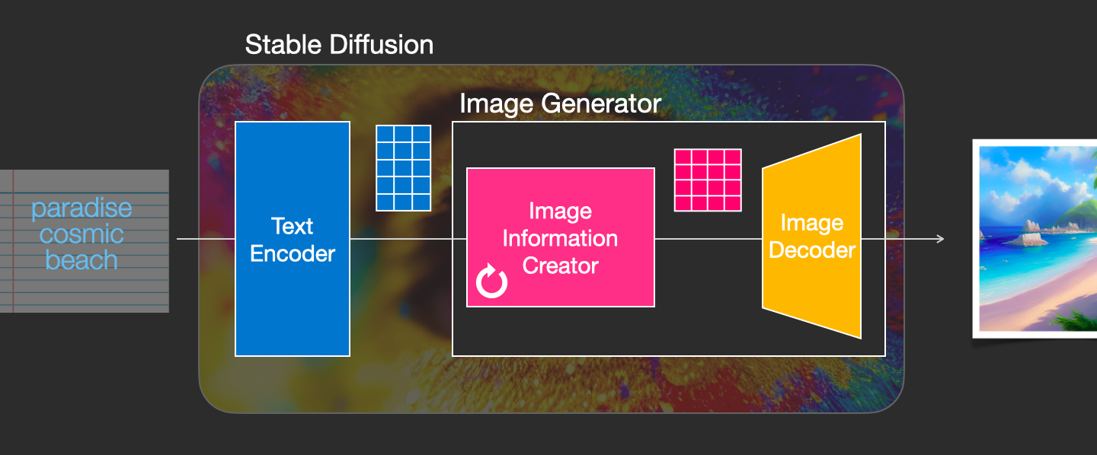
[4]

Slide 5
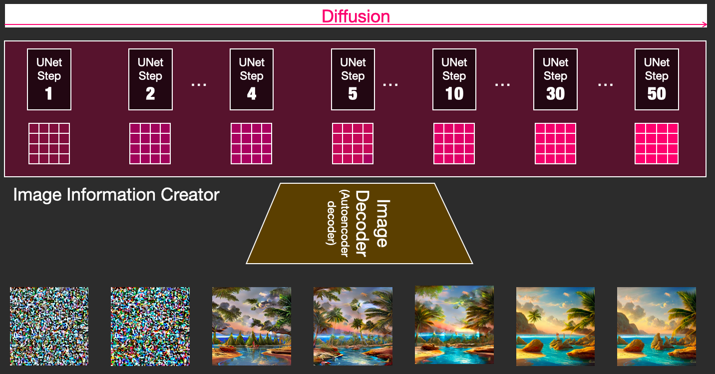
[5]

Slide 6
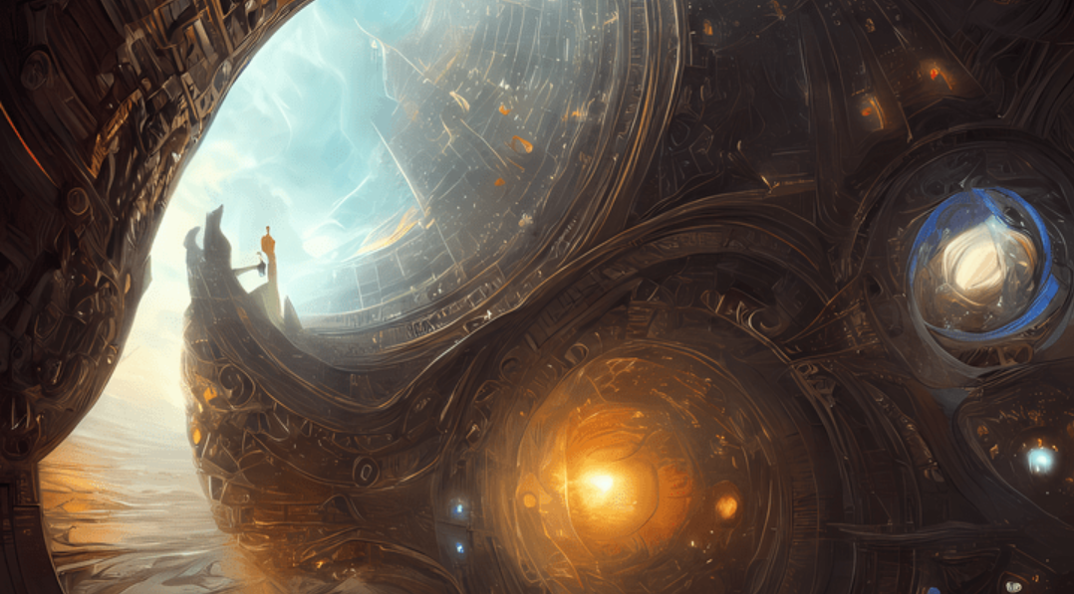
Практическая часть
[6]

Slide 7
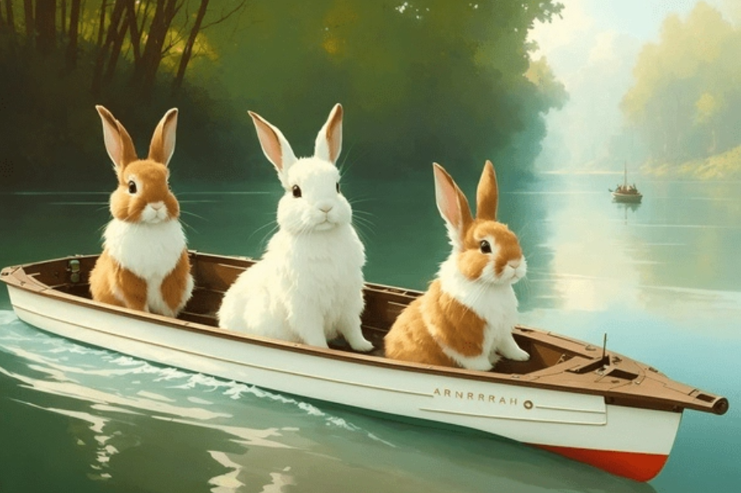
[7]

Slide 8
Промпты для генерации изображения
Ожидание:
«Зайцы путешествуют на лодке по реке»
Реальность:
Positive prompt: style photorealistic painting, cute bunnies on boat, river, HDR, masterpiece, smooth, sharp focus, illustration, golden ratio, art by greg rutkowski and alphonse mucha
Negative prompt: deformed, bad anatomy, disfigured, poorly drawn face, mutation,mutated, extra limb, ugly, disgusting, poorly drawn hands, missing limb, floating limbs, disconnected limbs, malformed hands, blurry, watermark, watermarked, oversaturated, censored, distorted hands, amputation, missing hands, obese, doubled face, double hands, b&w, black and white, sepia, person, human, people
Parameters: CFG scale: 6, Steps: 25, Sampler: DPM++ SDE, Seed: 1658491, Size: 768x512, Model hash: d8691b4d16, Denoising strength: 0.3, ENSD: 31337, Hires upscale: 2, Hires upscaler: R-ESRGAN 4x+ Anime6B
[8]

Slide 9
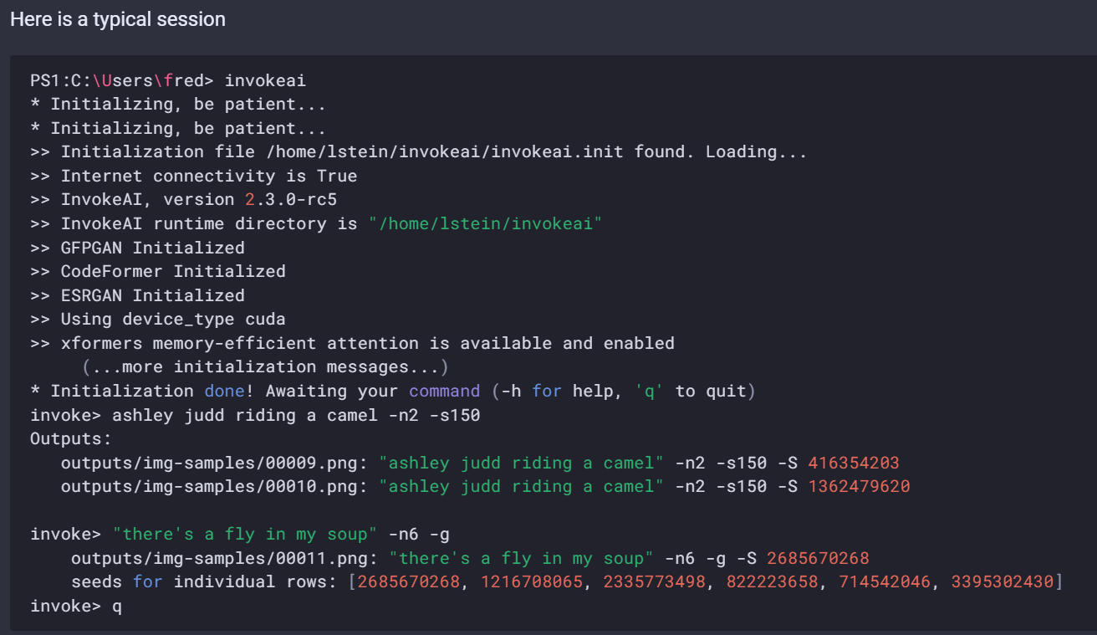
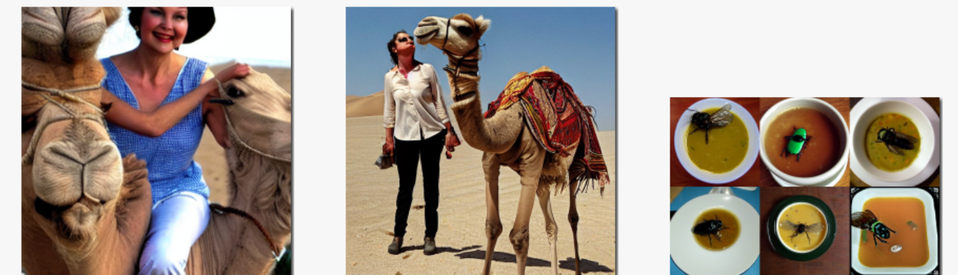
[9]

Slide 10
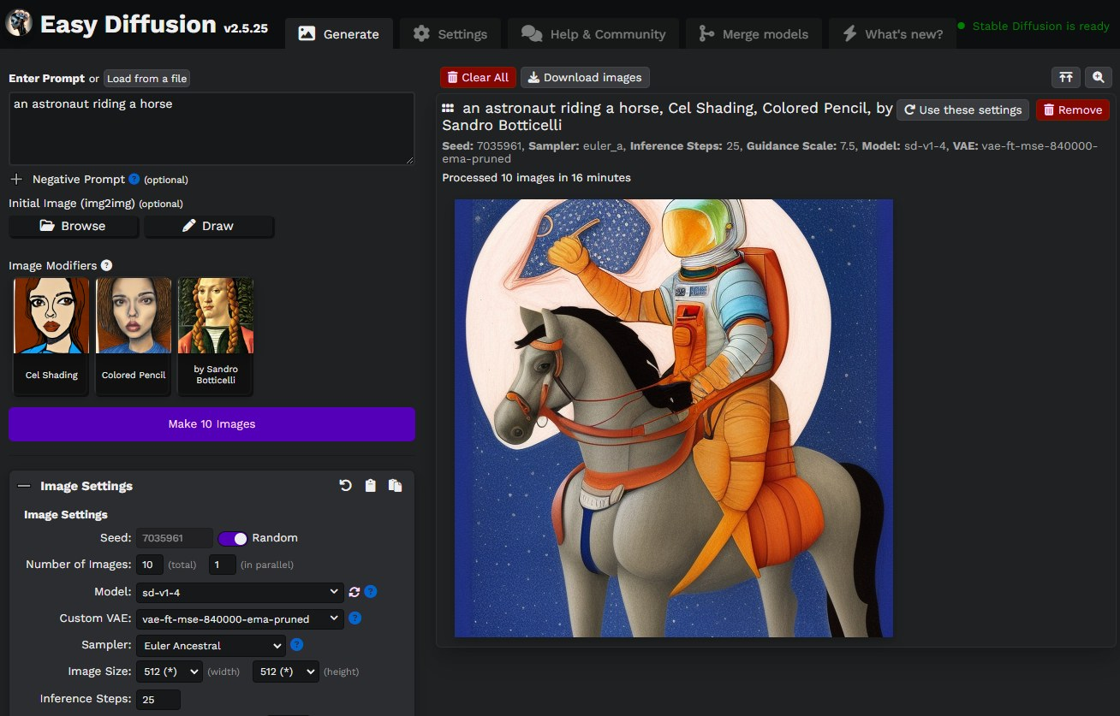
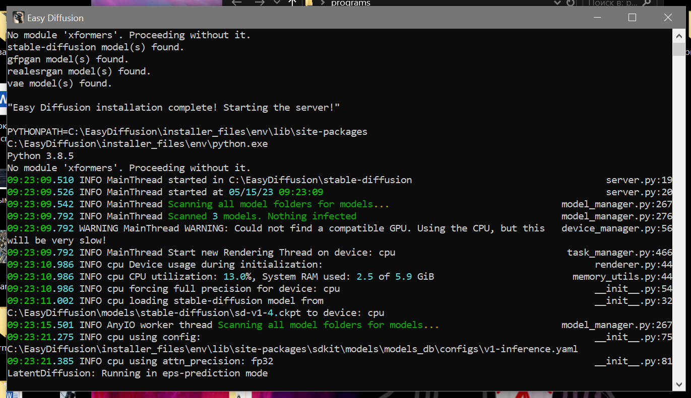
[10]
https://stable-diffusion-ui.github.io

Slide 11
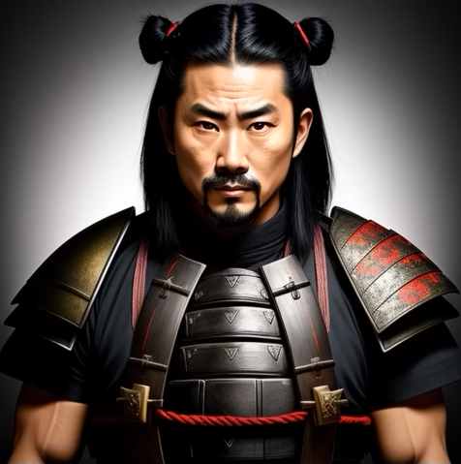
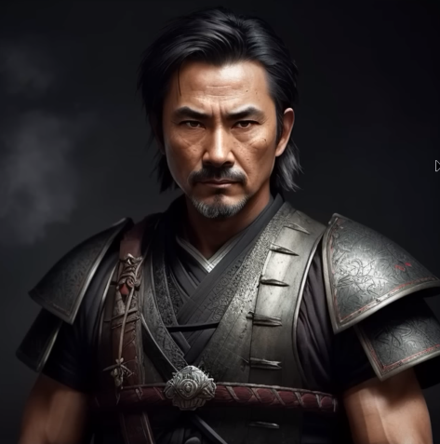
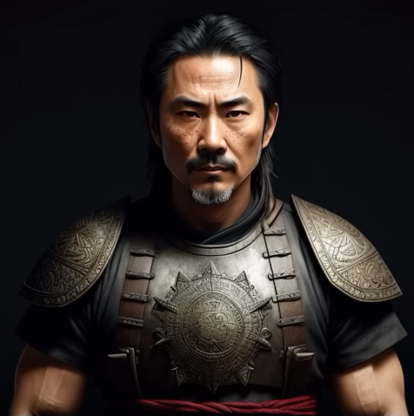
Модель Deliberate1
Модель Deliberate1 настроенная
«под midjourney» с помощью выбора sampling method
[11
как настроить: https://www.youtube.com/watch?v=P-JIcWqPdBQ

Slide 12
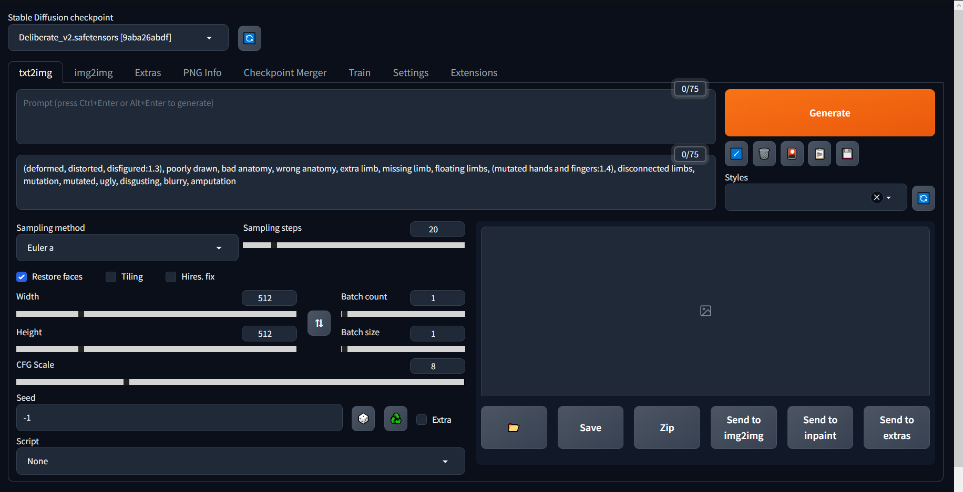
[12
https://github.com/AUTOMATIC1111/stable-diffusion-webui

Slide 13
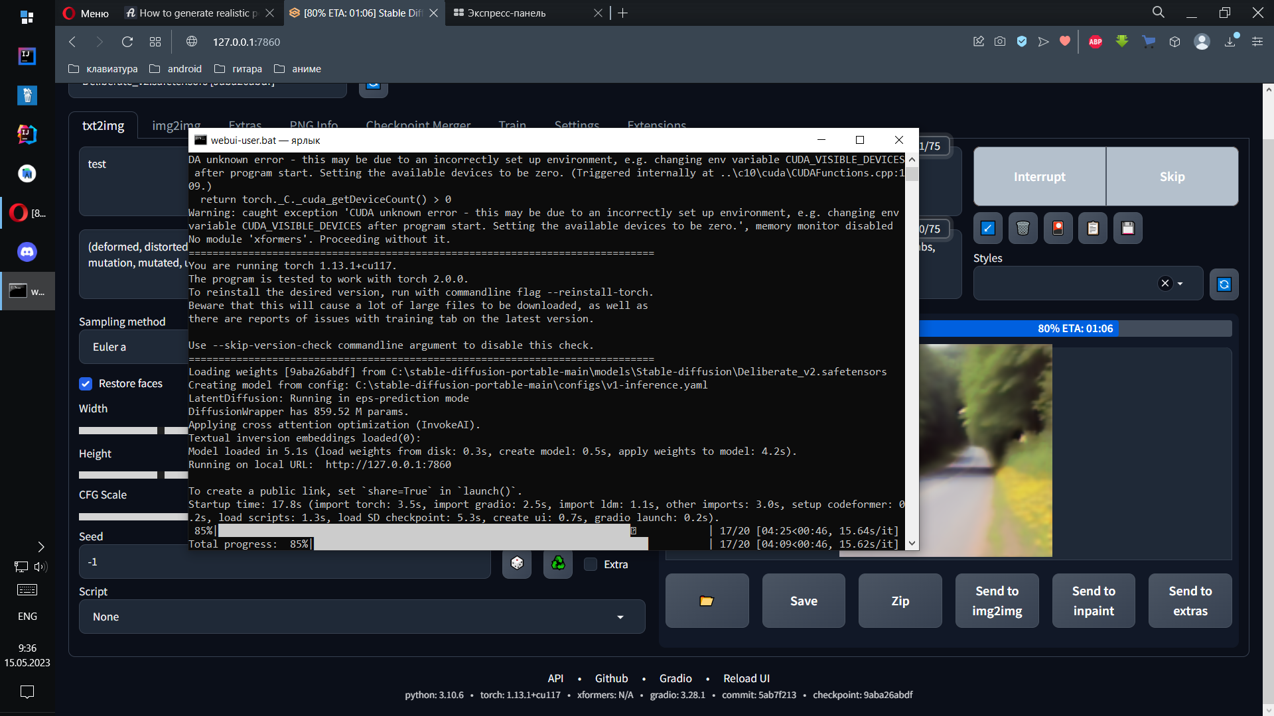
[13

Slide 14
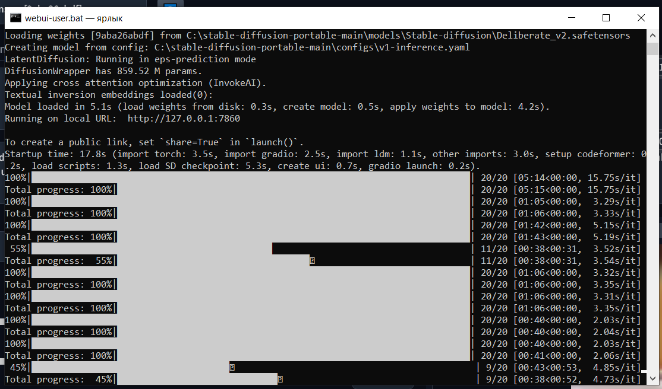
[14

Slide 15
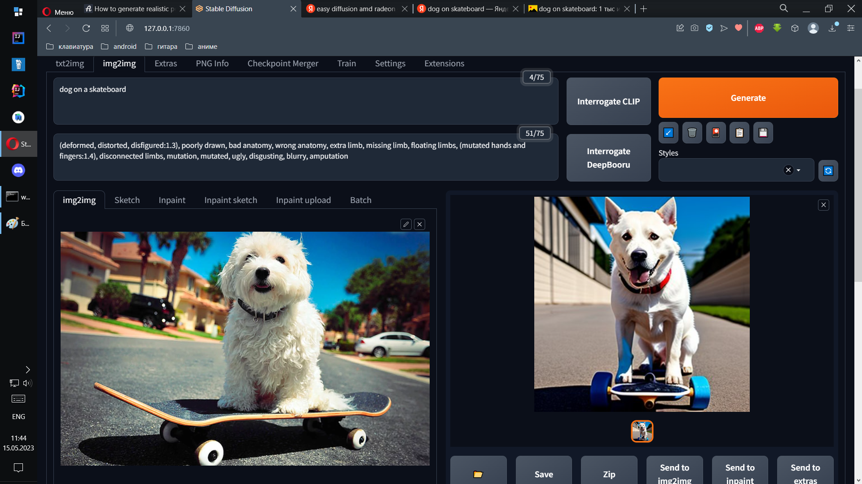
[15

Slide 16
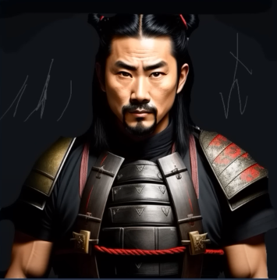
[16

Slide 17
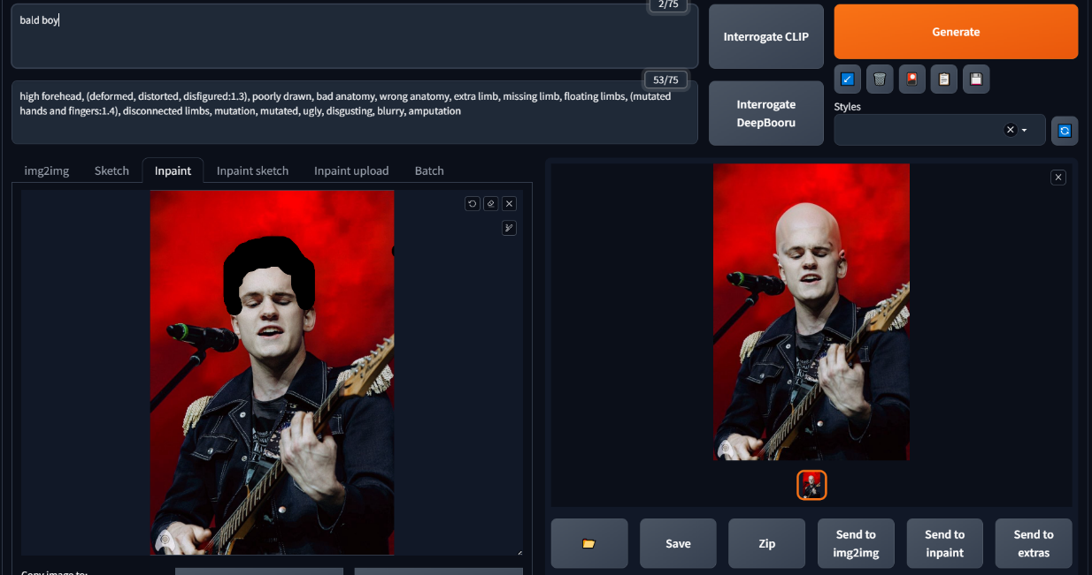
[17

Slide 18
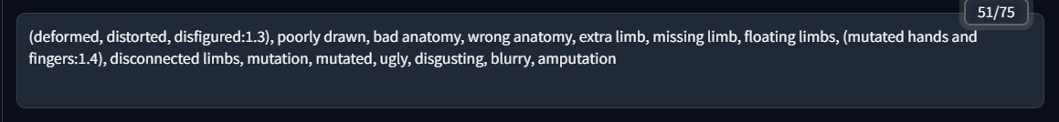
(deformed, distorted, disfigured:1.3), poorly drawn, bad anatomy, wrong anatomy, extra limb, missing limb, floating limbs, (mutated hands and fingers:1.4), disconnected limbs, mutation, mutated, ugly, disgusting, blurry, amputation
[18

Slide 19
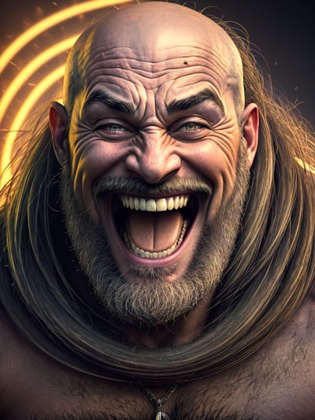
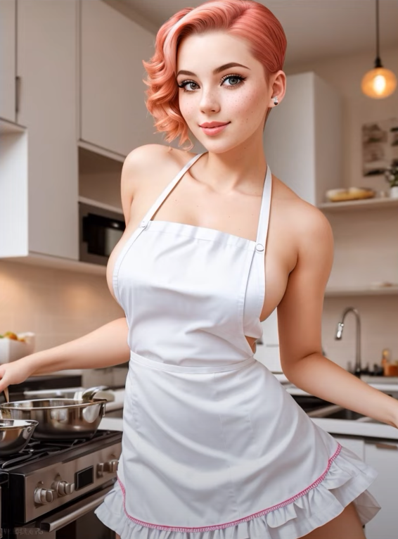
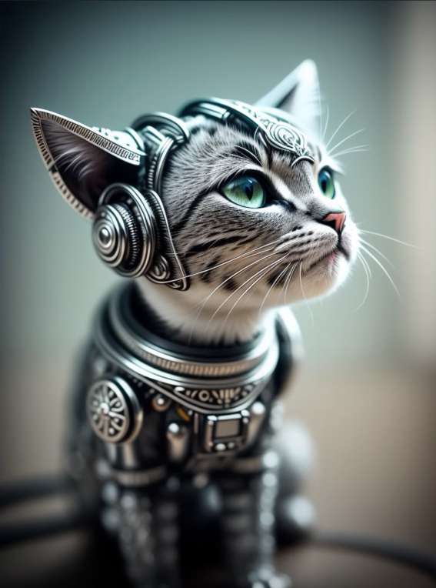
Промпт «Смеющийся бог»
обложка на превью у deliberate2
Промпт
«mecanical syber cat»
[19
https://www.youtube.com/watch?v=3q3g3C6kABU

Slide 20
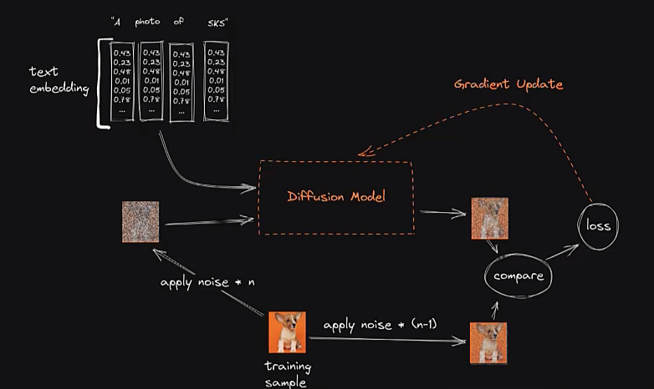
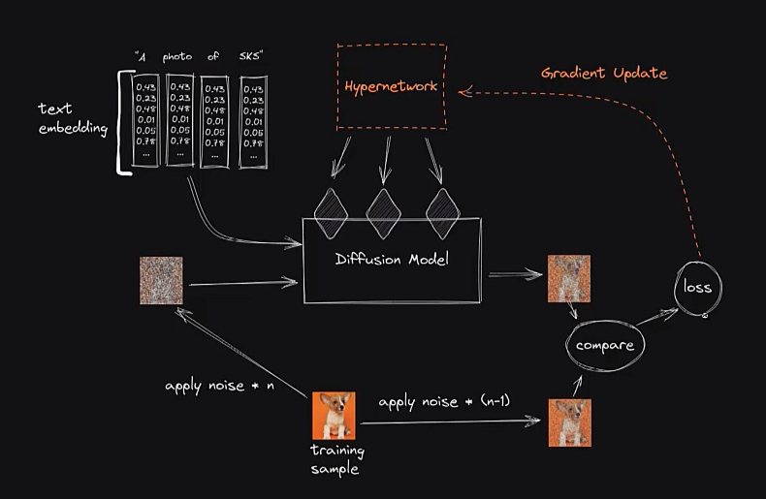
[20

Slide 21
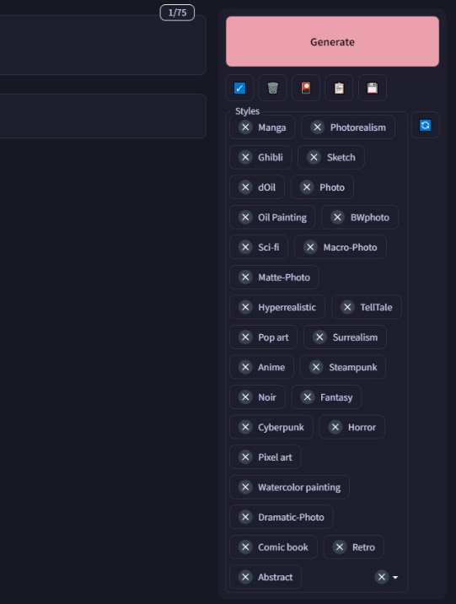
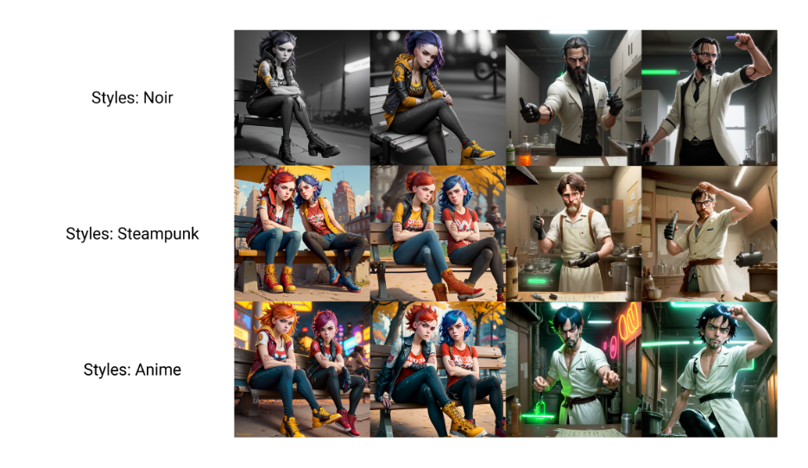
[21

Slide 22
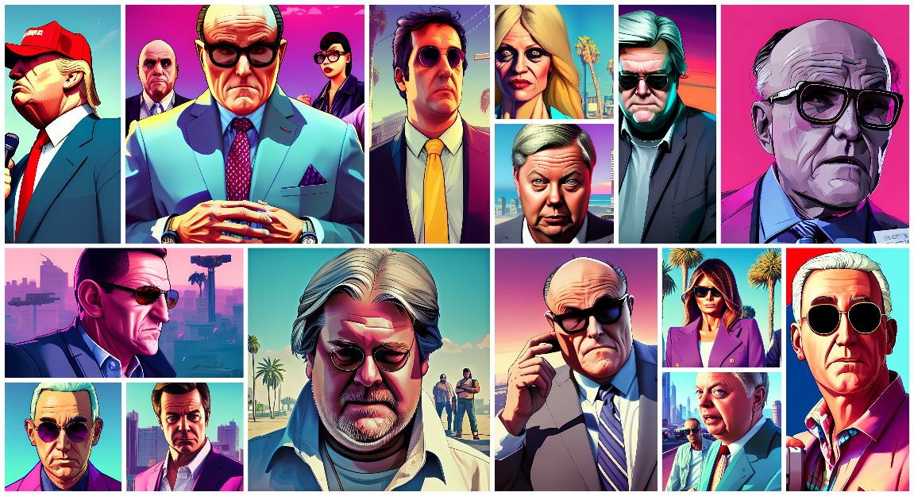
"Grant Theft Democracy" от volksvargas
https://www.reddit.com/r/StableDiffusion/comments/x4kl62/breaking_bad_better_call_saul_grand_theft_auto/
[22

Slide 23
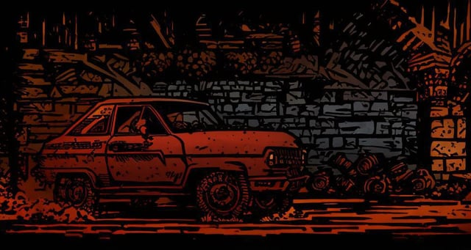
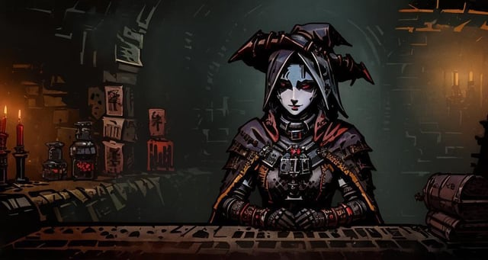
https://www.reddit.com/r/StableDiffusion/comments/13gw3om/i_made_a_lora_that_has_the_style_of_darkest/
[23

Slide 24
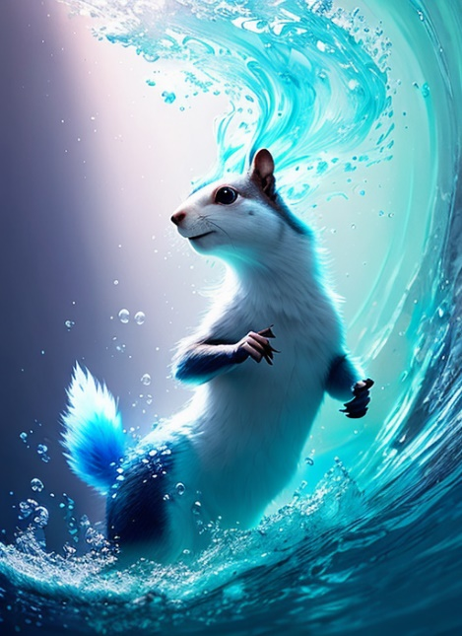
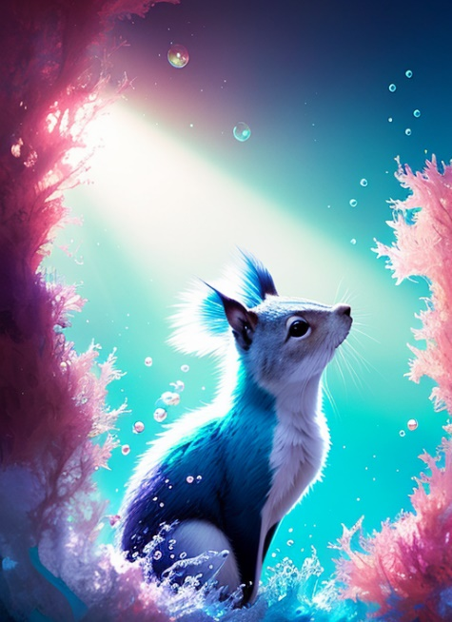
underwater, squirrel, oh no! bubbles, gods rays, alberto seveso art, cubism, colourful, water ink, ink water, ink cloud, alberto seveso art, loose painting style, intricate detail, cinematic lighting, octane render, 8k render, volumetric lighting, trending on artstation, sharp focus, studio photo, intricate details, highly detailed, by greg rutkowski, plain white background
[24
https://www.youtube.com/watch?v=VjWGMnp7ZzY

Slide 25
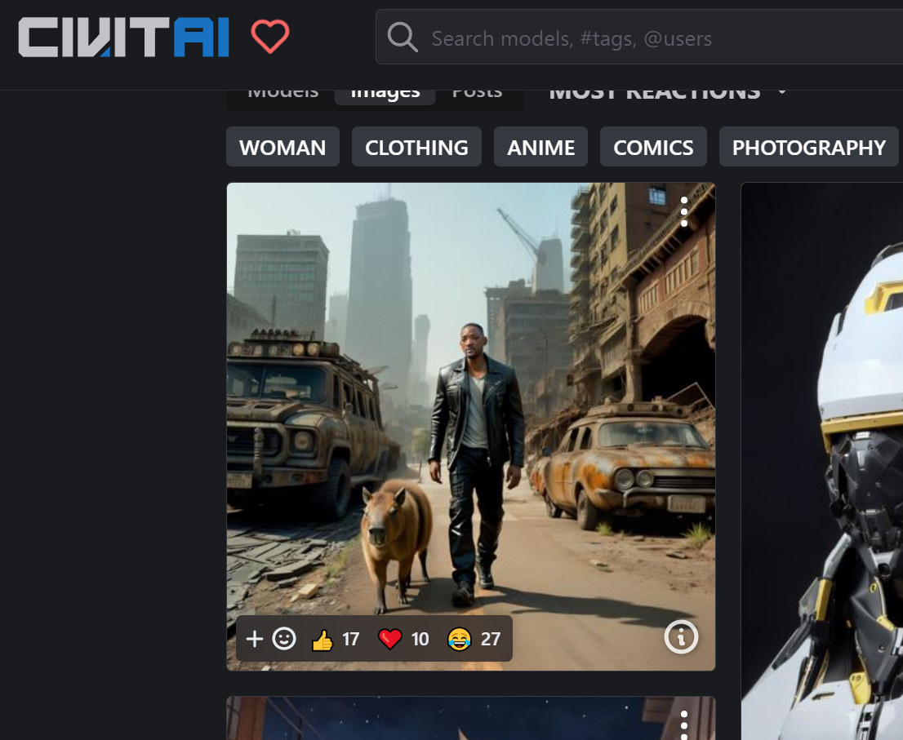
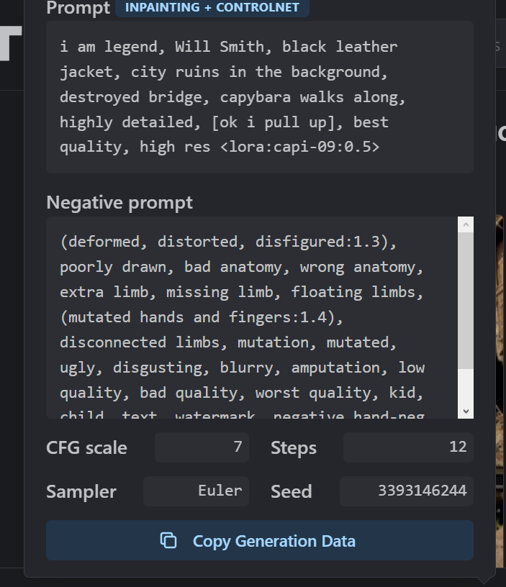
[25
https://civitai.com

Slide 26
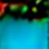
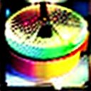
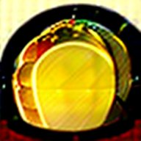
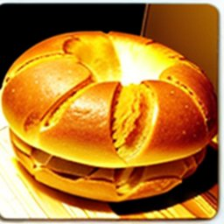
Позитивный промпт «Bread»
64x64 пикселя
128x128 пикселей
192x192 пикселя
256x256 пикселей
(с третьего раза)
[26
https://www.youtube.com/watch?v=6nthXso6iOE

Slide 27
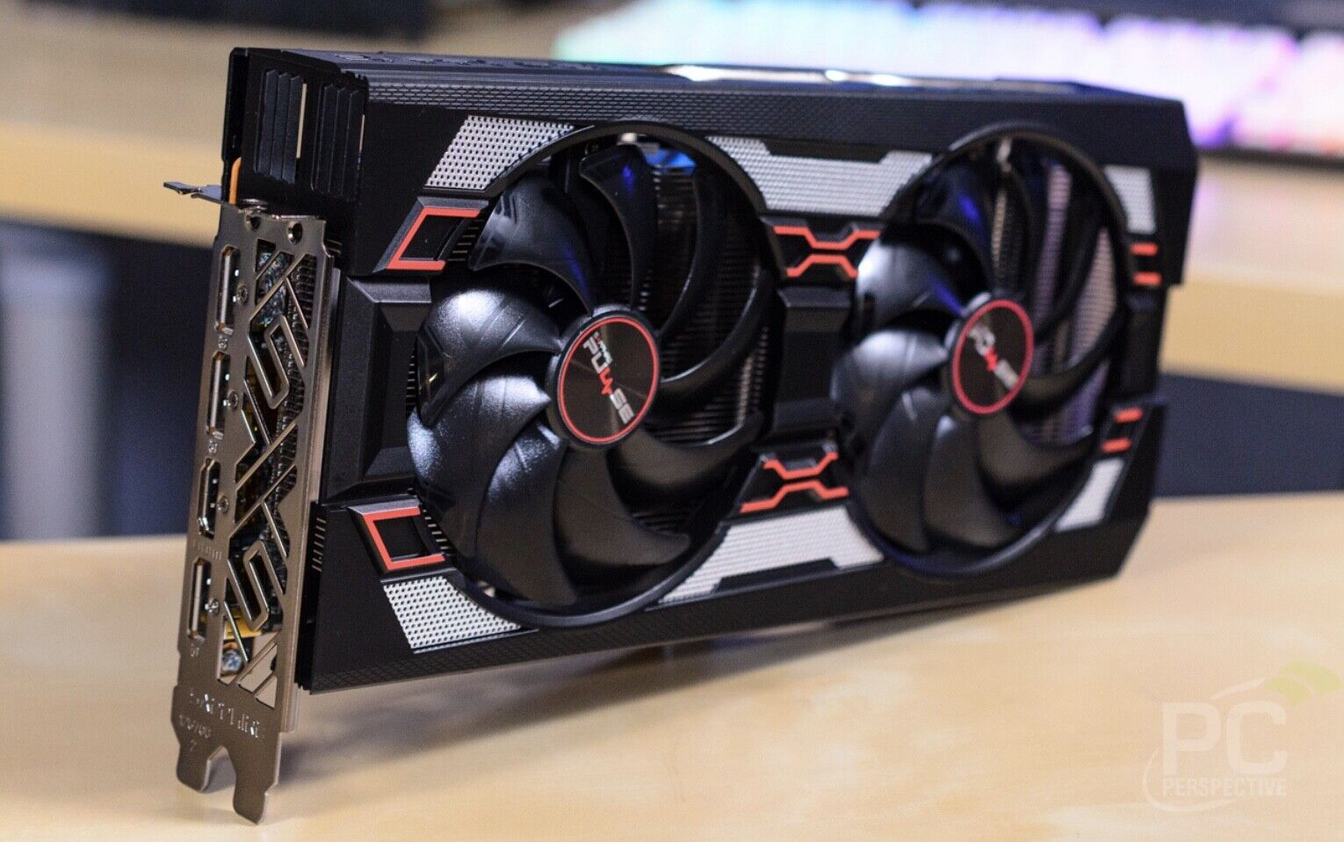
[27

Slide 28

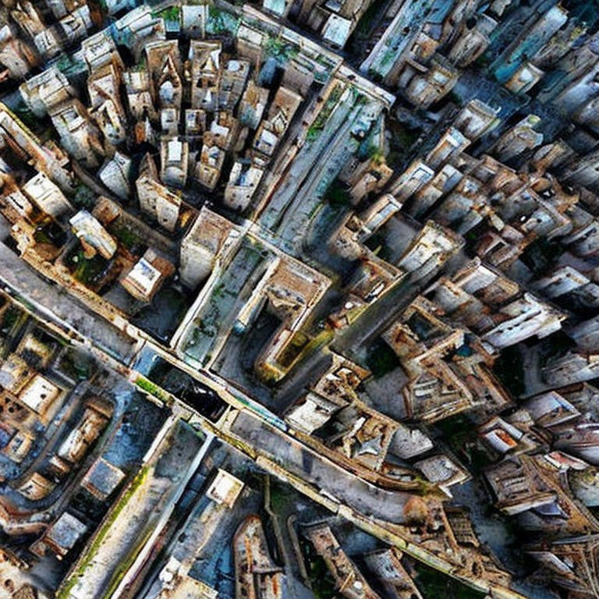
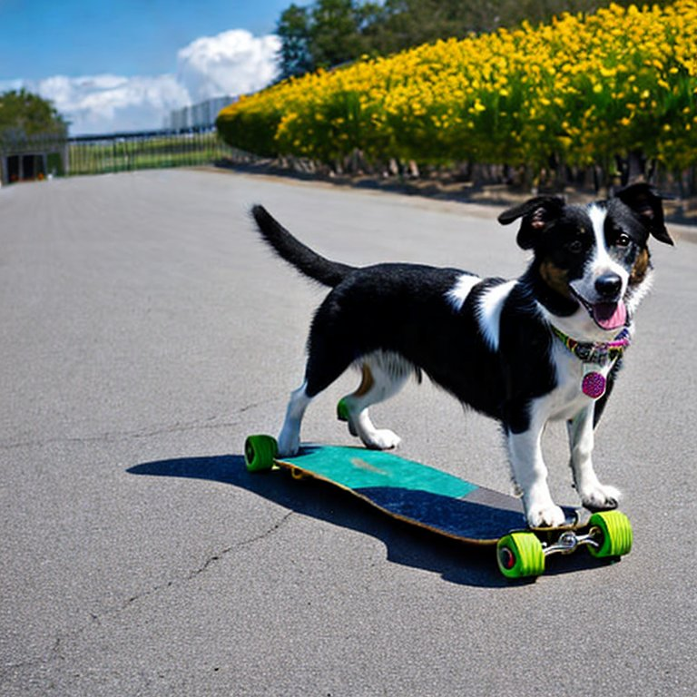
«an abandoned city from a bird's eye view»
«The dog on skateboard»
[28
https://stablediffusionweb.com/#demo

Slide 29
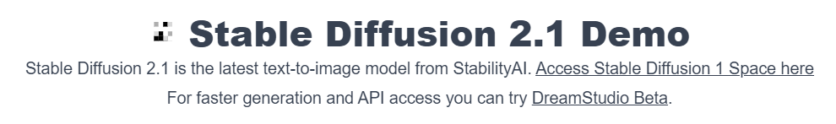
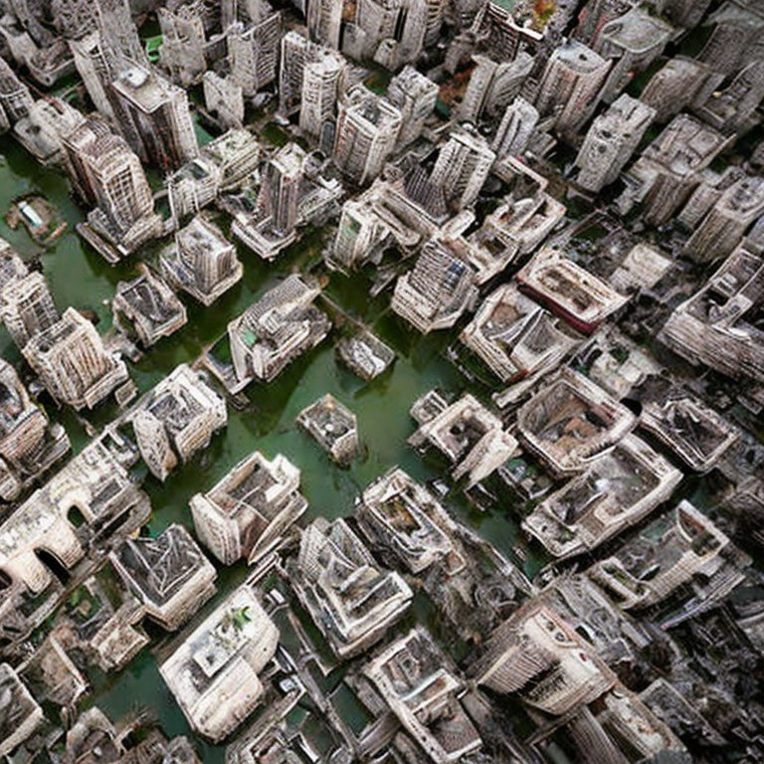
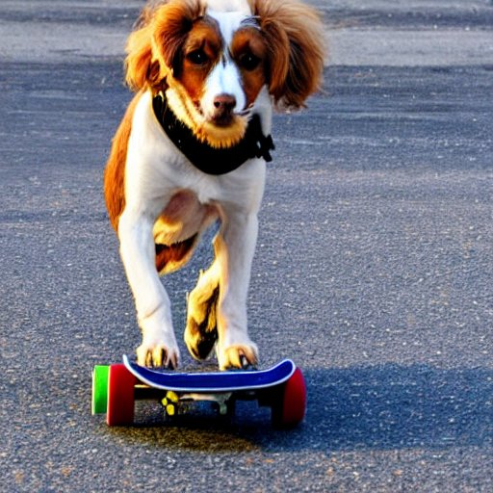
«an abandoned city from a bird's eye view»
«The dog on skateboard»
[29
https://huggingface.co/spaces/stabilityai/stable-diffusion

Slide 30
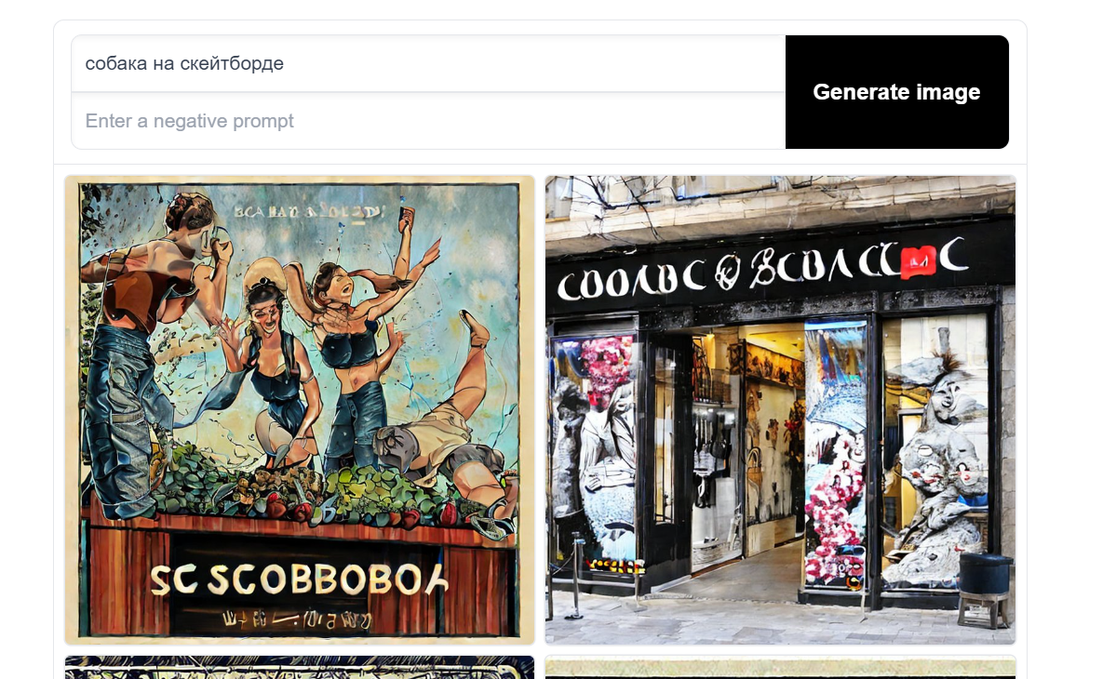
[30

Slide 31
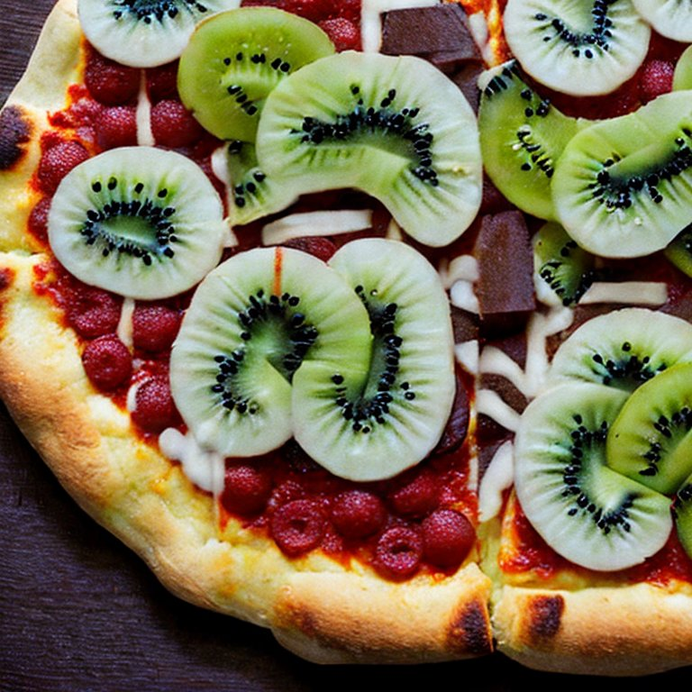
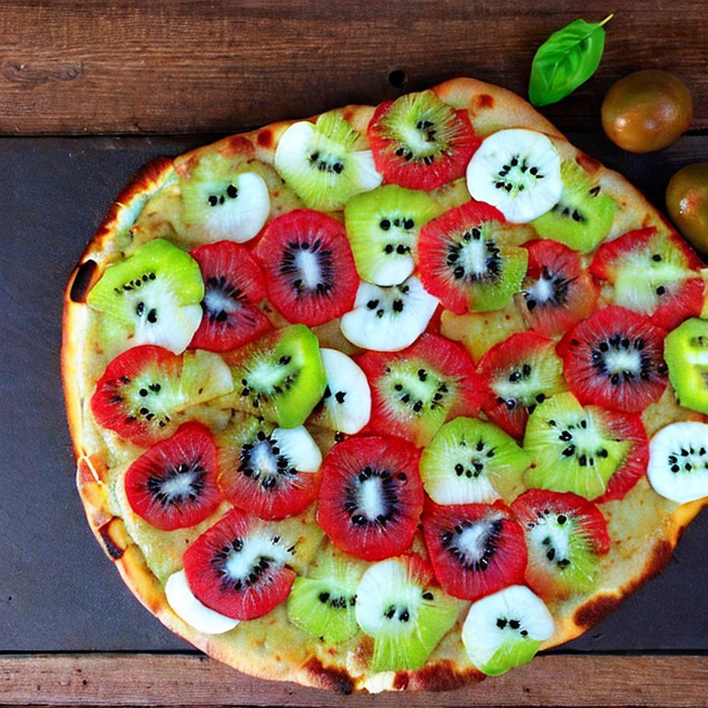
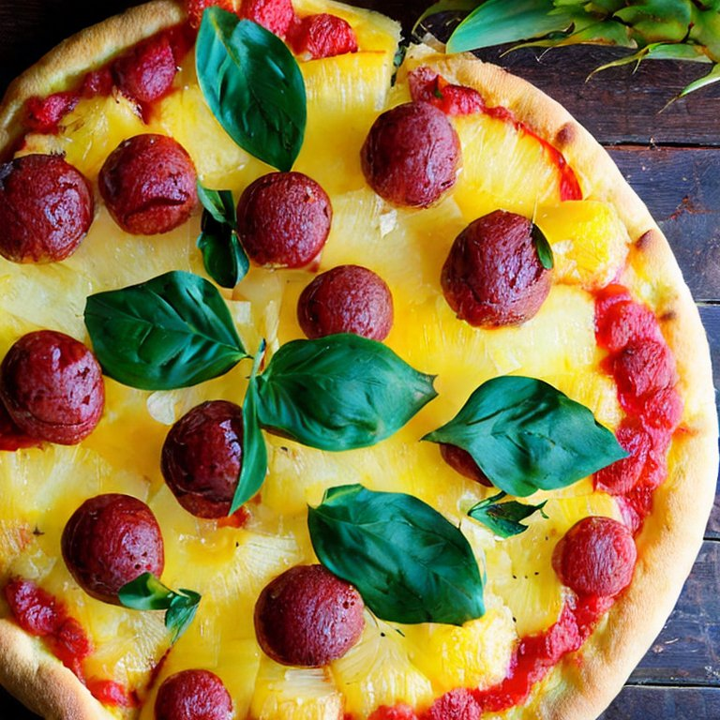
«pizza banana kiwi»
«a pineapple pizza»
[31

Slide 32
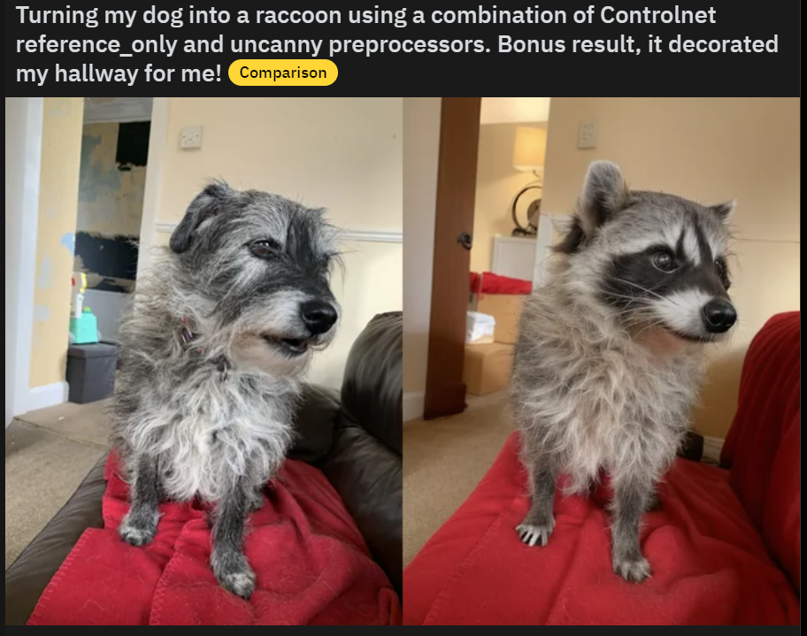


[32
https://www.reddit.com/r/StableDiffusion/

Slide 33


[K]

Slide 34

[34
https://www.youtube.com/watch?v=Tz4RSV-w_m0 (Dall-e)

